Slide 1
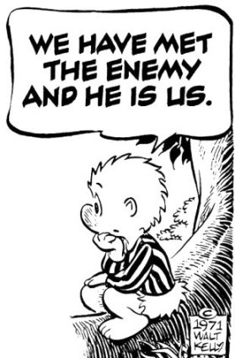
Economic Foundations of Political Legitimacy
Through Taxation, Spending, and Regulation, Governments Shape the Level and Content of Economic Activity. Greater intervention is shaped by perceptions and attitudes toward risk and which is viewed against a framework of individual and collective freedom of action.

Slide 3
Market vs. Government Failure
Standard assumptions for economic efficiency may fail to realize, thus leading to market failure and in which government failure may ensure.
Market Failure – A condition in which market prices fail to meet a standard of accounting for all costs and benefits that are essential to maximizing social economic efficiency. Market failure arises in the presence of perfect and imperfect asymmetric information, and incomplete property rights
Government Failure – A condition in which government efforts to correct for market failure leads to moral hazard and adverse selection.

Slide 4
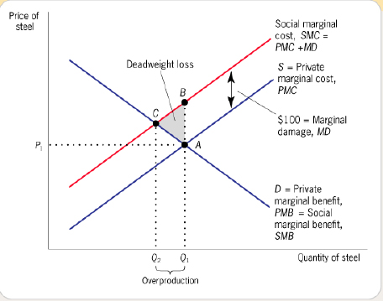
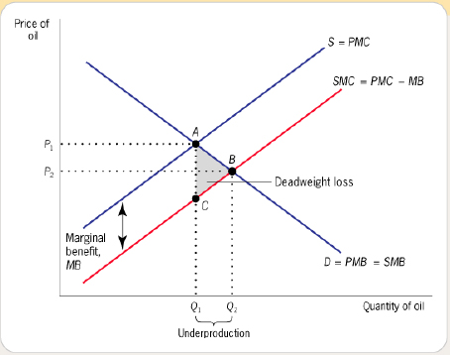
Externalities as a Source of Market Failure
An externality is an unintended consequence of an action on a third party other than a buyer and seller in a market transaction. Where externalities are present, market prices do not reflect the costs and benefits to society at large. Externalities provide an a priori basis of government intervention.
Negative Externalities Positive Externalities

Slide 5
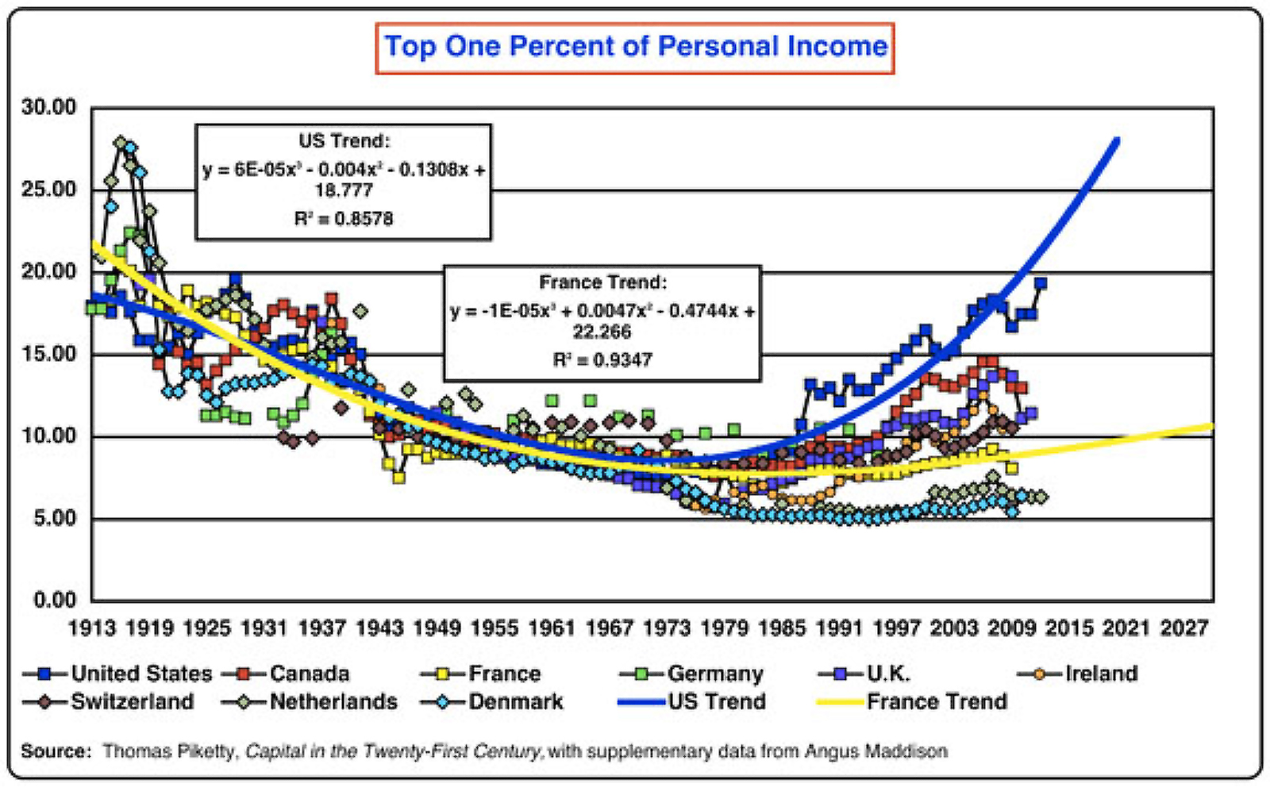
Externalities Can Also Affect the Distribution of Income and Wealth

Slide 6
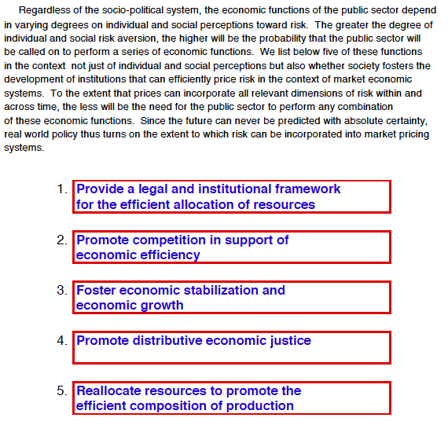
On the Economic Functions of the Public Sector

Slide 7
On the Economic Size of the Public Sector 1

Slide 8
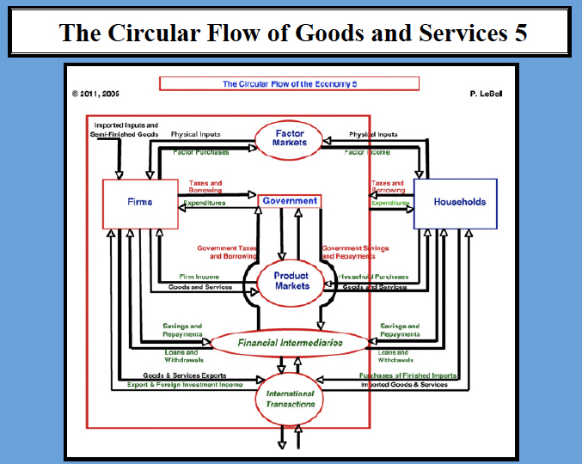
On the Economic Size of the Public Sector 2

Slide 12
Private and Government Health Care

Slide 13
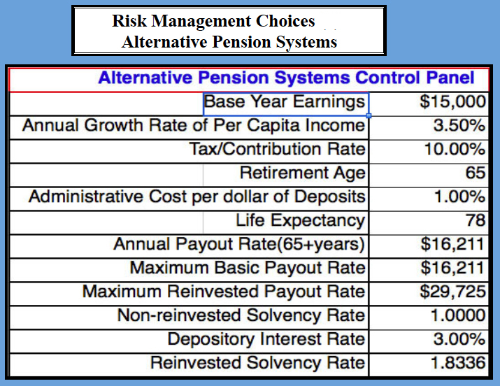

Slide 14
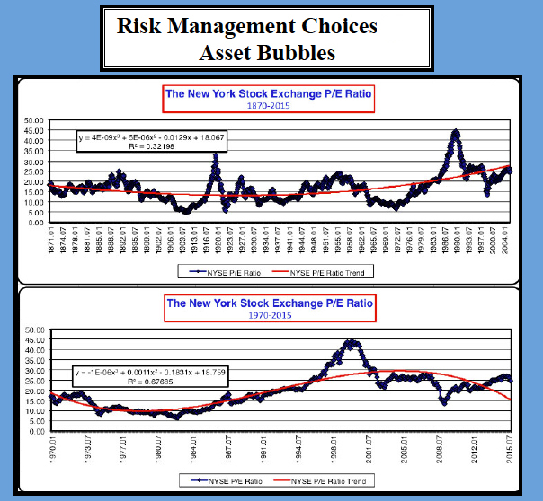
Equity Asset Valuations - 1

Slide 15
Equity Asset Valuations - 2

Slide 16
Discount Rates in Asset Valuations

Slide 17
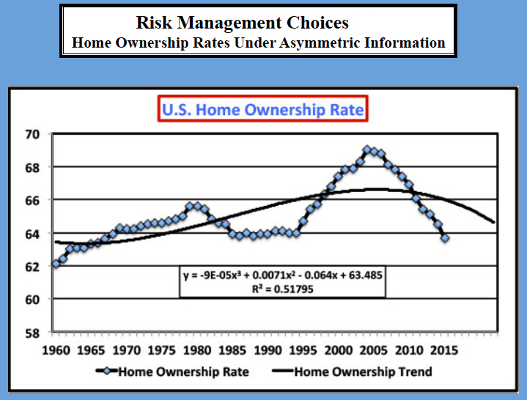

Slide 18
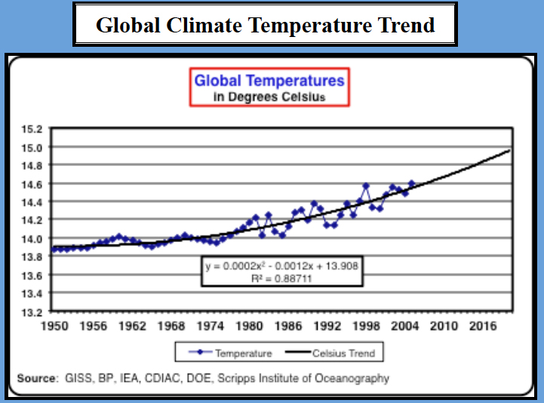
Can Market Economics Resolve Climate Change Risks?

Slide 20
Managing Sustainable Economic Growth through Markets of Government Intervention – Can Insurance Markets Be the Answer?

Slide 21
Economic Foundations of Political Legitimacy Revisited

Slide 22
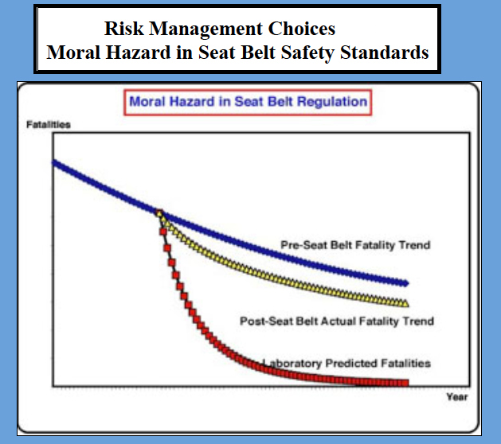
Moral Hazard and the Social Contract

Slide 23
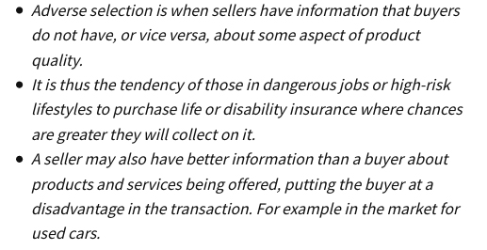
Adverse Selection and the Social Contract
Markets can fail under adverse selection but government intervention may not correct the failure

Slide 24
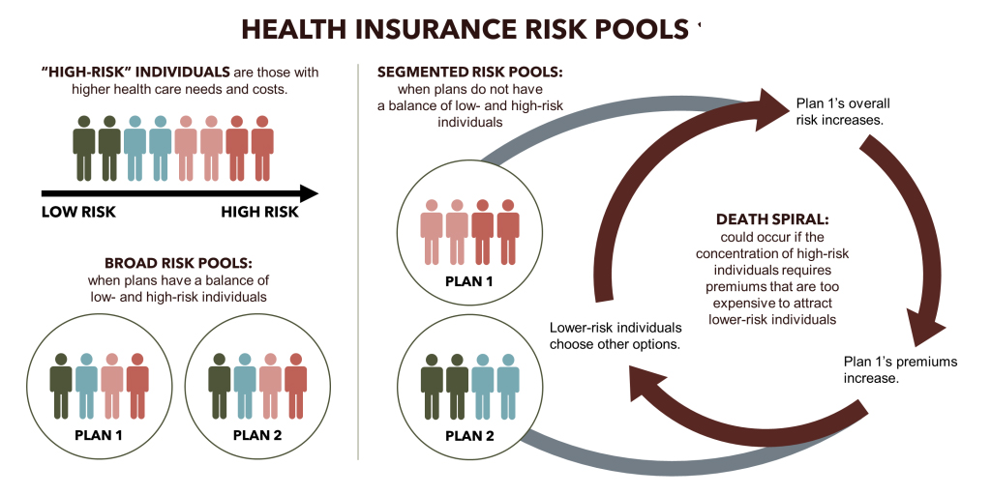
Adverse Selection Insurance and the Social Contract

Slide 25
Political Legitimacy and The Social Contract Revisited
When markets fail, pressure grows for government intervention. Markets fail when prices do not reflect social costs and benefits of the production and consumption of goods and services. Whether a macro-failure such as a Great Depression, or a micro-failure such as in individual products arises, debates about individual liberty and freedom of choice lose importance in favor of collective action. Once an economy reaches a level of sustained prosperity, efforts to restore the public-private spheres increase against government intervention. Perceptions of risk drive much of this debate, and given that much of these perceptions reside in the domain of neuroscience, there is no simple solution to the optimal mix of public and private sector institutions. Under these circumstances, the tendency to manipulate public opinion draws on emotional responses to risk. As such, the notion of rational economic decision-making remains as a normative standard against which irrational behavior may prevail. Economics alone does not define political legitimacy, but to the extent that it can provide some rational alternatives to the allocation of resources, it can inform public debate in ways that political systems often fail to adopt and uphold.

